Slide 1



PROJECT :- E-COMMERCE ANALYTICS CLIENT :- OLIST STORE
PRESENTED BY - NAGENDRA V KINI

Slide 2
SHORT INTRO INSIGHTS REGARDING PROJECT
For Client a Precise And Accurate Analysis Is Been Done For His Company With The Help Of Tableau.
With The Help Of Tool Tableau – Attractive And Simple To Understand Dashboard Has Been Made So That Client Can Get Overall Analysis Of His Demanded KPI’S .
Even Person From Non-technical Background Can Understand Dashboard With Ease.
In Last Slide Of Our Presentation Valuable Suggestion And An Overall Conclusion Has Been Provided Plus For Every KPI Extravagant Insights Has Also Been Provided This All Will Help Our Client Receive An Valuable/ Worthful Information Which By Applying To His Organisation Will Confirm An Positive Growth.
Lastly I Have Provided Bonus Suggestion Which I Felt Will Be Worth Sharing To Our Client ( Note – This All Suggestion , Insights And Conclusion Has Been Provided By Very Detail Analysis Of The Demanded Kpi’s By Using Tableau Tool, Everything Has Been Gone Through Various Verification Process So That The Information Which Has Been Provided To Our Client Makes His Organisation Growth To An 100x Times From It’s Present State.

Slide 3
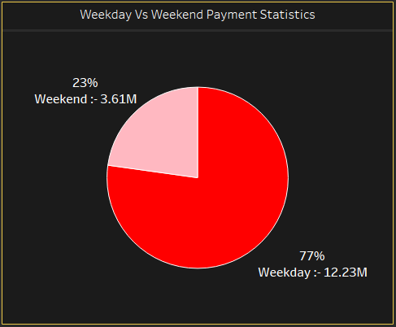
KPI 1
Weekday Vs Weekend Payment Statistics
The pie chart shows the distribution of orders by weekend/weekday. 77% of orders were placed on weekdays while only 23% were placed during weekends. This indicates a higher demand for the product or service during the weekdays, which could be due to factors such as people being at work or having more time to shop during weekdays compared to weekends. It is important to note that this is just a snapshot of data and may not represent a universal trend.

Slide 4
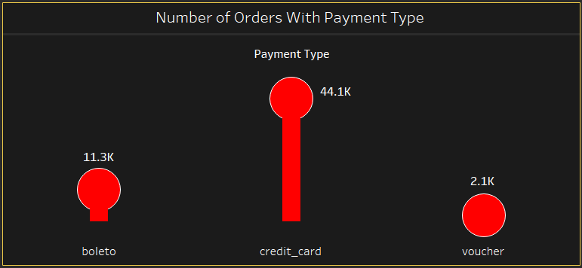
KPI 2
Number of orders with Review score 5 & payment type as Credit card
The Analysis shows the number of orders with different payment types. It shows that credit card is the most common payment type, accounting for 44.1K orders, followed by boleto with 11.3K orders, and voucher with 2.1K orders. This suggests that credit card is the most popular payment method among customers, followed by boleto and voucher.

Slide 5
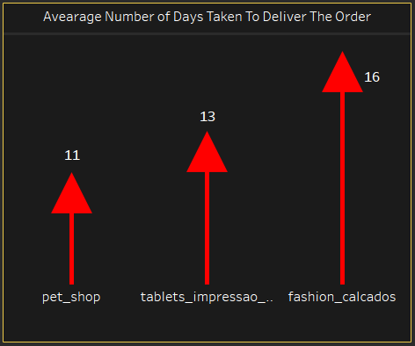
KPI 3
Average number of days taken to deliver the order for category pet shop
The bar chart shows the average delivery days for each product category in the Olist dataset. The pet shop category has the highest average delivery days, with a value of 11 days. This suggests that products in the pet shop category might take longer to be delivered than products in other categories. This could be due to factors such as the size and weight of pet supplies, the need for special handling or storage, or the distance between the seller and the buyer.

Slide 6
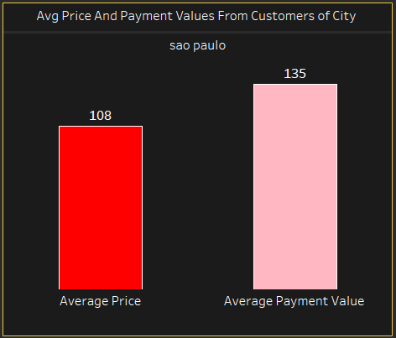
KPI 4
Average price and payment values from customers of Sao paulo city
The bar chart displays the average price and average payment value from customers in the city of Sao Paulo. The average payment value, depicted in pink, is significantly higher than the average price, shown in red. This suggests that customers in Sao Paulo tend to pay more than the average price for goods and services. The difference between the two values could be attributed to factors such as high-end purchases, additional fees, or premium services offered in the city.

Slide 7
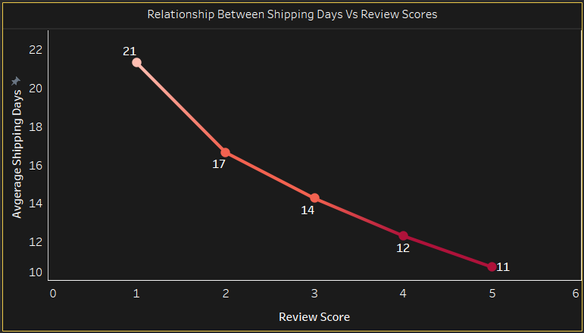
KPI 5
Relationship between Shipping days Vs Review scores
The graph shows a strong negative correlation between review score and average shipping days. This suggests that customers who receive their orders faster tend to give higher reviews. As the average shipping days increases, the average review score decreases. This trend highlights the importance of prompt shipping in achieving high customer satisfaction.

Slide 8
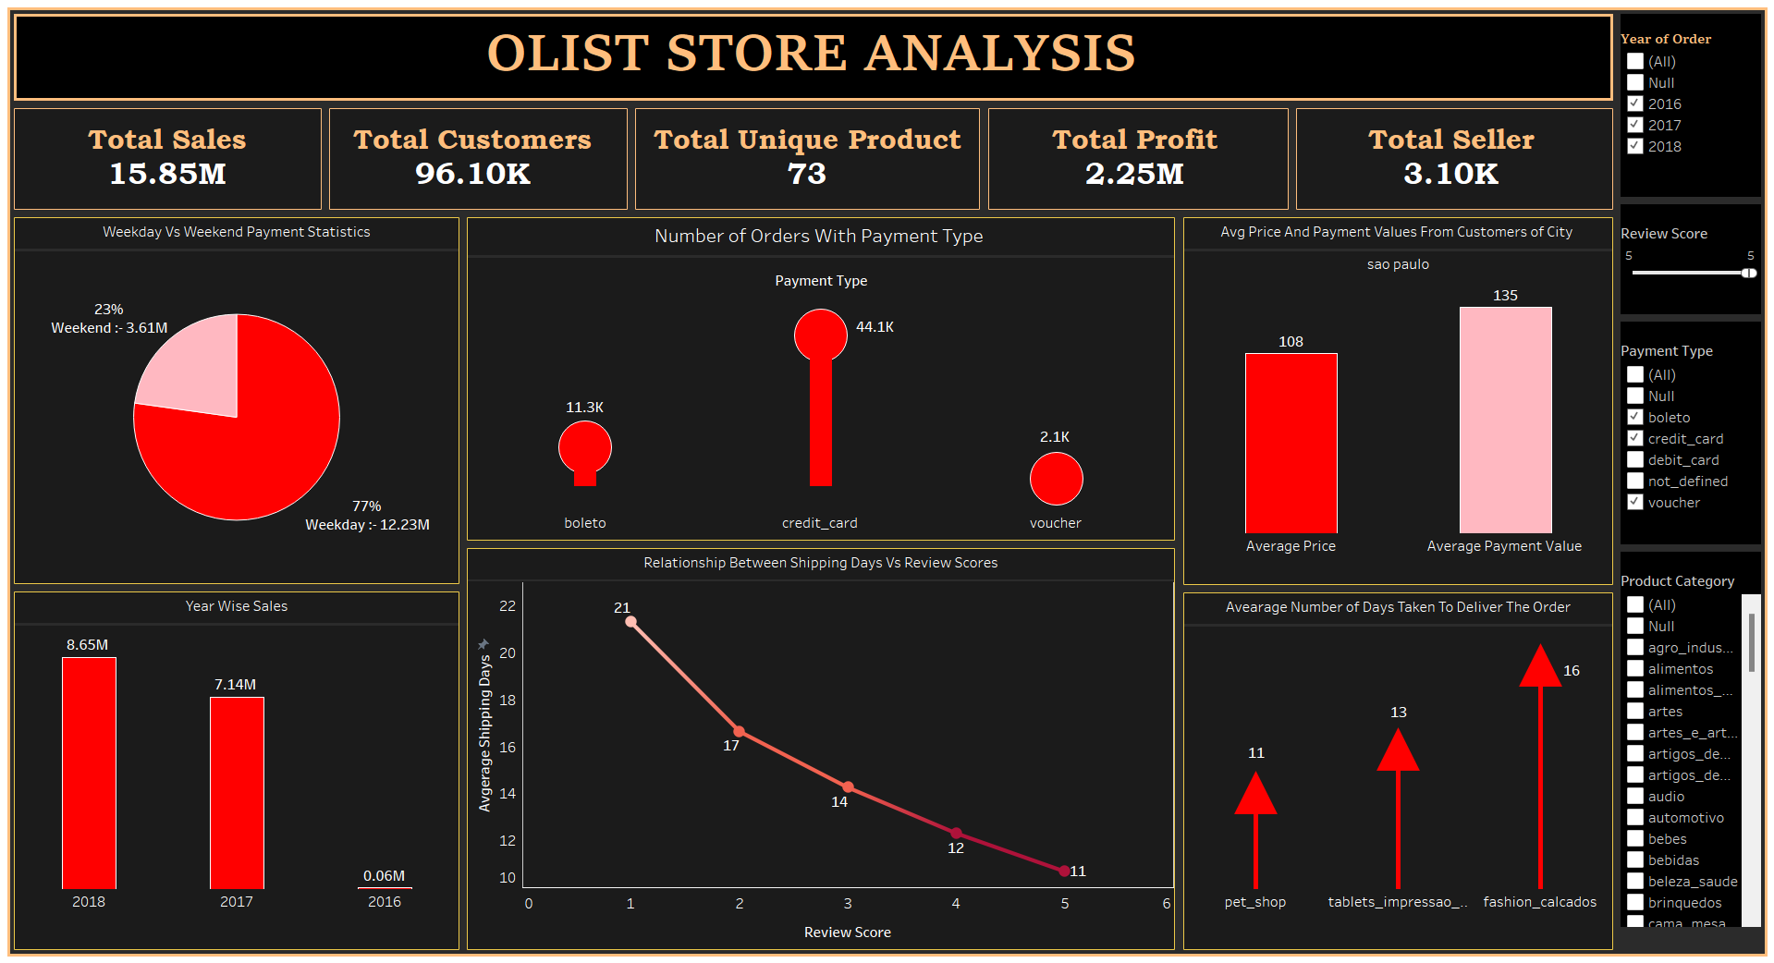
DASHBOARD

Slide 9
10 MOST EXTRAVAGANT INSIGHTS WHICH I FELT WORTH TO SHARE
Strong Sales Performance :- The company has achieved total sales of 15.85 million, indicating a strong sales performance.
Large Customer Base :- The company boosts a significant customer base with 96,100 customers, suggesting widespread market reach.
Diverse Product Portfolio :- The company offers a diverse product range, with 73 unique products, contributing to its customer base.
Profitability :- The company has a substantial profit of 2.25 million, signifying efficient operations and successful revenue generation.
Credit Card Preferred :- Credit card payment is the most popular method, accounting for 44.1k orders, indicating a preference for convenient and secure transactions.
Short Shipping Time :- The average shipping time is around 13 days, suggesting efficient logistics and a focus on timely delivery.
High Customer Satisfaction :- The relationship between shipping days and review scores shows a slight negative correlation, implying that faster shipping generally leads to higher customer satisfaction.
Strongest Sales in 2018 :- Year- wise sales show the highest sales in 2018, indicating continued growth and a successful strategy.
Sao Paulo as a Key Market :- The data on average price and payment value from customers in Sao Paulo suggests it is a significant market for the company.
Wide Product Categories :- The wide range of product categories indicates a diverse customer base and caters to a variety of needs and preferences

Slide 10
NOW 10 MOST IMPORTANT SUGGESTIONS/ RECOMMENDATION I WOULD LIKE TO SHARE FOR OUR CLIENT
Optimize Weekend Sales Strategy :- Since weekend sales account for only 23% of total sales, consider implementing targeted marketing campaigns or promotions to boost weekend sales.
Expand Product Offerings :- With 73 unique products, consider expanding the product portfolio to cater to emerging customer needs and stay competitive in the market.
Enhance Credit Card Payment Experience :- Given the popularity of credit card payments, consider streamlining the payment process, offering rewards, or providing exclusive benefits to credit card customers.
Invest in Logistics Efficiency :- With an average shipping time of 13 days, consider investing in logistics optimization to reduce shipping times and improve customer satisfaction.
Leverage Customer Reviews :- Analyze customer reviews to identify areas for improvement and implement changes to increase customer satisfaction and loyalty.

Slide 11
NOW 10 MOST IMPORTANT SUGGESTIONS/ RECOMMENDATION I WOULD LIKE TO SHARE FOR OUR CLIENT
6.Target Sao Paulo Customers :- Develop targeted marketing campaigns to cater to the Sao Paulo customer base, which appears to be a significant market for the company.
7.Analyze and Improve Profit Margins :- Review profit margins across different product categories and identify opportunities to optimize pricing, reduce costs, or improve operational efficiency.
8.Develop a Loyalty Program :- Implement a loyalty program to reward repeat customers, increase customer retention, and encourage positive word-of-mouth.
9.Invest in Data Analytics :- Leverage data analytics to gain deeper insights into customer behavior, preferences, and pain points, and use these insights to inform business decisions.
10.Explore New Payment Options :- Consider offering alternative payment options, such as digital wallets or cryptocurrencies, to cater to evolving customer preferences and stay competitive in the market.
These suggestions are designed to help the company build on its strengths, address areas for improvement, and stay competitive in the market.

Slide 12
CONCLUSION
The Olist store analysis highlights a successful online business with a high volume of sales, numerous customers and a wide range of products. The data suggests a strong preference for credit card payments and a positive customer experience, indicated by the declining average shipping days as review scores increase. The store's strong performance in Sao Paulo presents an opportunity to expand to other cities, potentially replicating its success in a new market. However, the low number of unique products suggests a potential opportunity to expand the product catalog and cater to a wider customer base. Further analysis of customer demographics and product categories could identify high-demand areas for future growth and profitability.

Slide 13
THANK YOU

